Slide 1



MATERNAL BONY PELVIS
Dr Shanthi Serene Sylum V MD(Hom)
Professor & HOD
Dept: Obstetrics & Gynaecology

Slide 2

An articulated pelvis consist of 4 bones & they are united by 4 joints.
Bones are –
Iliac bones – 2
Sacrum - 1
Coccyx - 1
Joints are –
Sacro iliac joints – 2
Sacro coccegial jt – 1
Symphysis pubis - 1

Slide 3
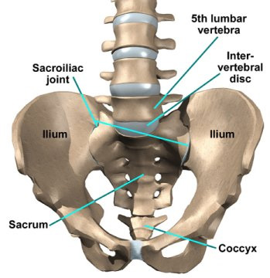

Slide 4
Anatomically pelvis is divided into 2
False pelvis
Or
the greater pelvis
or
pelvis major
True pelvis
Or
The lesser pelvis
Or
Pelvis minor

Slide 5
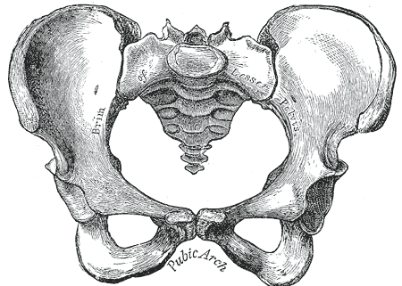
Bony land marks of pelvic brim from anterior to posterior -
1. upper border of symphysis pubis
2. Pubic crest
3. Pubic tubercle
4. Pectineal line
5. Iliopubic eminence
6. Iliopectineal line
7. Sacroiliac articulation
8. Anterior border of the ala of sacrum
9. Sacral promontory

Slide 6
False pelvis
It is formed by the iliac portion of the innominate bone.
It got only a little obstetric significance.
Practically it’s measurements are not taken now.
It’s function is to support uterus during pregnancy.
Boundary –
Posteriorly – Lumbar vertibrae
Laterally - iliac fossa
anteriorly - Anterior abdominal wall

Slide 7
Measurements of False pelvis
1. interspinous diameter
2. Intercristal diameter
3. Baudeloque’s diameter / Ext conjugate
4. Inter trochanteric diameter
(These diameters have no clinical values)

Slide 8
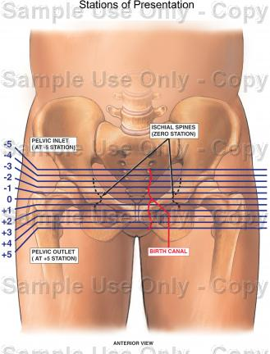
1. Interspinous diameter
Transverse distance between outer lips of anterior superior iliac spines.
about 22 - 25cm
ie (9 -10”).

Slide 9
2. Intercristal diameter
Transverse distance between outer lips of iliac crests at the widest part .
about 25 – 28 cm.
ie 10 – 11”

Slide 10
3. Baudeloque’s diameter or External conjugate
Antero posterior distance between tip of last lumbar vertebra & mid point of superior border of symphysis pubis.
It measures 19 cm.( 71/2”)
Baudeloque believed that true conjugate can be obtained by deduction of 3 ¼” from External conjugate

Slide 11
4. Inter-trochanteric diameter
Maximum width between greater trochanters.
about 31cm.

Slide 12
True pelvis

Slide 13
True pelvis
This forms the bony birth passage of foetus.
It is shallow in front & deep posteriorly.
Bounded
anteriorly by symphysis pubis which measures 4 cm
posteriorly by sacrum & coccyx measuring 11.5 cm

Slide 14
For descriptive purpose it is devided into 3
1. Pelvic inlet / brim
2. Pelvic cavity
3. Pelvic outlet

Slide 15
1. Pelvic inlet / brim
Inlet is formed by –
1. upper border of symphysis pubis
2. Pubic crest
3. Pubic tubercle
4. Pectineal line
5. Iliopubic eminence
6. Iliopectineal line
7. Sacroiliac articulation
8. Anterior border of the ala of sacrum
9. Sacral promontory

Slide 16
Things to be known in the
Pelvic inlet / brim
Shape
Plane
Inclination
Sacral angle
Axis
Diameters

Slide 17
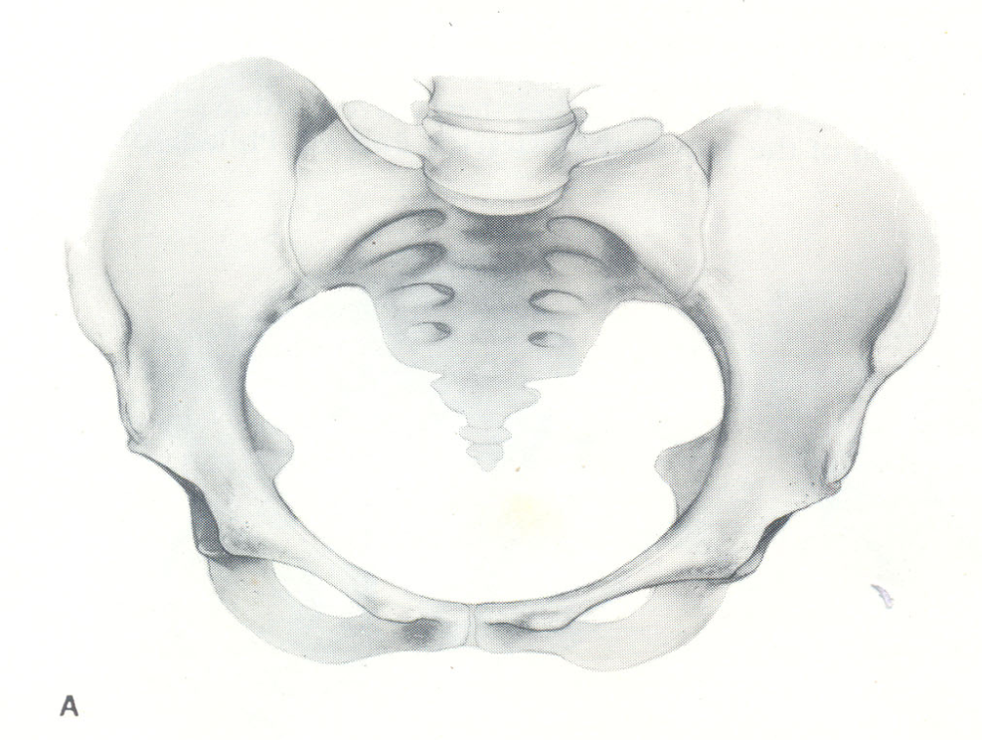
Shape -
heart-shaped or rounded with slight antero posterior flatening due to forward projection of sacral promontory.

Slide 18

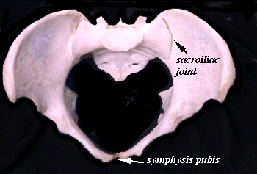
Plane or superior strait
It is the space of pelvic brim through which an imaginary plane is drawn.

Slide 19
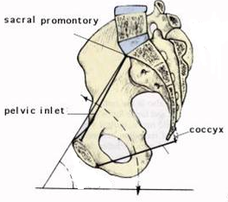
Inclination
Pelvis is tilted forward in the erect posture.
So the plane of inlet makes an angle of 55 with the horizontal plane. This angle is called angle of inclination.
angle of inclination can be measured in
another way too.
Ie. the angle formed between the plane of inlet & the front of the body of V lumbar vertebra which measures 135 .
55
55
It can be measured
radiographically.

Slide 20
High inclination
If the angle of inclination is increased due to sacralization of 5th lumbar vertebra, it is called high inclination.
It got obstetric significance like –
It produce delay in engagement because the uterine axis fails to coincide with the inlet.
It favours occipito posterior position.
It produce difficulty in descent of the head due to long birth canal & flat sacrum.

Slide 21
low inclination
If the angle of inclination is lessened due to lumbarization of 1st piece of sacral vertebra, then it is called low inclination.
It facilitates early engagement.

Slide 22
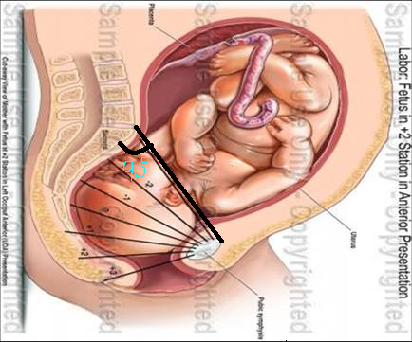
Sacral angle
It is the angle formed by plane of brim & 1st two pieces of sacrum.
Normaiiy it is more than 90 .
Narrow sacral angle suggest flat sacrum in funnel pelvis.

Slide 23
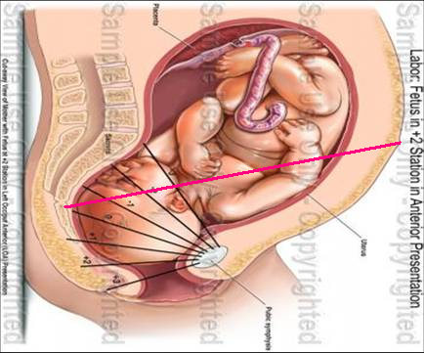
Axis
Mid perpendicular line drawn to the plane of inlet directed downward & backwards.
When extended, this line passes through the umbilicus to coccyx.
This Axis of inlet should coincide with the uterine axis for the easy passage of foetus through the brim.

Slide 24
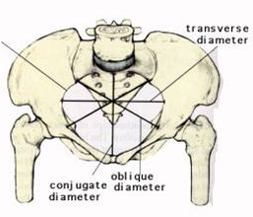
Diameters
1. Antero posterior diameter
2. Obstetric conjugate
3. Diagonal conjugate
4. Oblique diameter
5. Transverse diameter

Slide 25
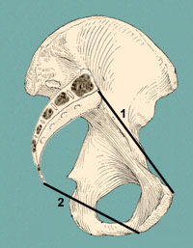
Antero diameter posterior
Syn – True conjugate, anatomical conjugate, conjugate vera
Extends from midpoint of sacral promontory to midpoint of upper border of symphysis pubis.
Measures 11 cm (4 ¼”)
It cannot be estimated directly.
It is indirectly measured by deducting 1.2 cm (1/2”) from the diagonal conjugate.

Slide 26
2. Obstetric conjugate
It is the distence between midpoint of sacral promontory to prominent bony projection in the mid line on the inner surface of the symphysis pubis.
It is the shortest Antero posterior diameter of the inlet.
It Measures 10 cm (4”)
It cannot be clinicaly estimated .
It is indirectly measured by deducting 1.5 - 2 cm (3/4”) from the diagonal conjugate..

Slide 27
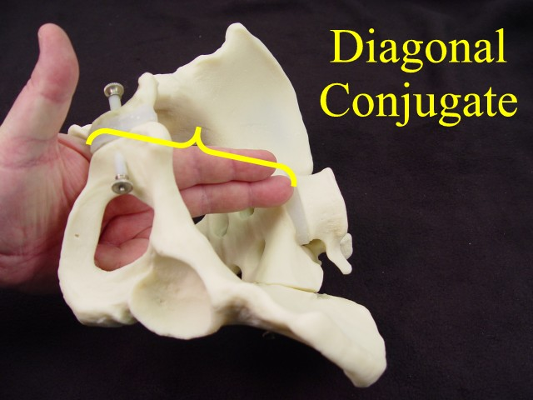
3. Diagonal conjugate
It is the distence between the lower border of symphysis pubis to the midpoint on sacral promontory.
It Measures 12 cm (4 3/4”)
It is measured during pelvic assessment in late pregnancy or in labour.

Slide 28
How to measure Diagonal conjugate ?
Place pt in dorsal position.
Take aseptic precautions.
Extended index & middle fingers of gloved rt hand are introduced into vagina.
Try to palpate through posterior vaginal fornix against hollow of the sacrum from below upwards with an attempt to reach the sacral promontory through the sacral concave curve. { it is difficult in normal pelvis}
The point at witch the bone recedes from the fingers is the sacral promontory.
Mark a point just below the symphysis pubis over the rt gloved finger.
The distence between the sacral promontory & the Marked point gives the Diagonal conjugate .

Slide 29
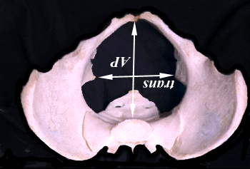
4. Oblique diameter
It measures from one sacroiliac joint to opposite iliopectenial eminance.
They are two in no.
Rt o d – Rt to Lt.
Lt o d - Lt to Rt
Measures 12 cm
(4 ¾”)
L O
R O

Slide 30
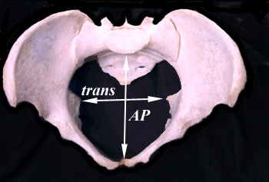
5. Transverse diameter
Maximum distance between two farthest points on the iliopectenial eminance.
It measures 13 cm
(5 ¼”)
It lies closer to sacral promontory at a distance of 4 cm
4 cm

Slide 31
6. Sacro cotyloid diameter
It is the distence between the mid point of the sacral promontory to iliopectenial eminance.
It represcents the space occupied by the biparietal diameter of the head while negotiating the brim in flat pelvis.

Slide 32
Cavity

Slide 33
Things to be known in the Cavity are -
plane of greatest pelvic dimension
Shape
boundary
Diameters

Slide 34
Cavity
Cavity is the segment of pelvis bounded above by the inlet & below by plane of least pelvic dimensions.
Shape is almost round.

Slide 35
Plane
it is the plane of greatest pelvic dimension & it is the most roomy plane in true pelvis.
Plane extend from
Ant - midpoint of posterior surface of symphysis pubis
Post - junction of 2nd & 3rd sacral vertebrae
Later – ischial bone over middle of acetabulum.
Shape of plane – Round
Diameters
Anteroposterior – 4 ¾”(12 cm)
Oblique – 4 ¾”(12 cm)
Transverse – 4 ¾”(12 cm)

Slide 36
Plane
Plane of least dimensions. Extends throughlower margine of symphysis pubis,tip of the sacrum and ischial spines.Antero-post diameter about 11.5cm, Transverse diamete about10.5cm.

Slide 37
outlet

Slide 38
The lower circumference of the pelvis is very irregular; the space enclosed by it is named the inferior aperture or outlet
And is bounded behind by the point of the coccyx, and laterally by the ischial tuberosities.
These eminences are separated by three notches: one in front,
The pubic arch, formed by the convergence of the inferior rami of the ischium and pubis on either side.

Slide 39
The other notches, one on either side, are formed by the sacrum and coccyx behind, the ischium in front, and the ilium above; they are called the sciatic notches;
In the natural state they are converted into foramina by the sacrotuberous and sacrospinous ligaments.
When the ligaments are in situ, the inferior aperture of the pelvis is lozenge-shaped, bounded, in front, by the pubic arcuate ligament and the inferior rami of the pubes and ischia; laterally, by the ischial tuberosities; and behind, by the sacrotuberous ligaments and the tip of the coccyx.

Slide 40
Outlet
Obstetrical Outlet Boundary
Shape
Plane
Axis
Diameters
Antero posterior
Transverse
Posterior sagittal
Anatomical Outlet
Boundary
Shape
Plane
Axis
Diameters
Antero posterior
Transverse
Posterior sagittal
Subpubic angle
Pubic arch

Slide 41
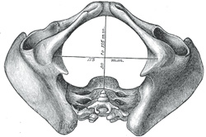

Obstetrical Outlet Anatomical Outlet
It is the segment of pelvis bounded by the plane of the least pelvic dimensions & below by the anatomical outlet.
Its anterior wall is deficient at the pubic arch.
Lateral walls are formed by ischial bones.
Posterior wall forms coccyx
Or bony outlet.
bounded
Anteriorly - inferior border of symphysis pubis Laterally – ischiopubic rami ,
ischial tuberosity,
, sacrotuberous and sacrospinous ligaments posteriorly - tip of coccyx.
It consist of two triangular planes with a common base formed by joining 2 ischial tuberosities.
Ant apex - at inferior border of pubic arch.
Post apex – at the tip of the coccyx.

Slide 43
PELVIC OUTLET
Boundary
Anteriorly - inferior border of symphysis pubis,
Laterally - pubic bone,
ischium
, sacrotuberous and sacrospinous ligaments posteriorly - tip of coccyx.
Planes of pelvic outlet
They lie on two triangular planes with base joining two ischial tuberosites due to downward projection of the ischial tuberosites.
Shape - oval

Slide 44
Diameters
Antero posterior -
5 ¼” (13cm)
extends from mid point of inferior border of symphysis pubis to tip of coccyx.
posterior point becomes tip of sacrum when coccyx is displaced backward during delivery of fetal head.
OBLIQUE - 4 ¾” (12cm)

Slide 45
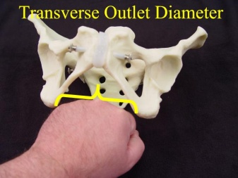
Transverse - measures 4¼” (10.6cm) measuring from medial border of the ischail tuberosities.This is called TRANSVERSE DIAMETER OF OUTLET (TDO)
It can be clinically measured.

Slide 46
Post sagital diameter Distance from mid point of line between ischial tuberosities and external surface of tip of scrum about 7.0cm.

Slide 47
Sub pubic angle
It is formed by the descending rami of pubic bones.
It measures 90 degree or more.
subpubic arch is wide and round disc of 9.4cm diameters.
Diameter of well flexed vertex can pass through pubic arch at a distance of 1cm from midpoint of inferior border of symphysis.
This distance is called waste space of Morris.
9.4cm

Slide 48
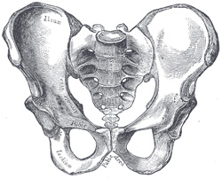
If the waste space Morris is more than 1cm due to narrow subpubic angle, available antero posterior diameter of outlet becomes less,
and fetal head had to pass injuring perineum or even gets arrested .

Slide 49
MIDPELVIS
MIDPELVIS is the narrowest segment of true pelvis lying between obstetric outlet below and roomy pelvic cavity above.

Slide 50
MIDPELVIS
Plane.
Plane at midpelvis is called plane of least pelvic dimension.
Boundaries-
anteriorly lower border of symphysis pubis,
inner aspect of inferior ramus and
obturator foramen,
ischialspine,
sacrospinous ligament and
tip of sacrum.
Ischail spines form two important landmarks of this plane.
Shape of plane-anteroposterior oval.

Slide 51
Diameters
.
Anteroposterior-
5 1/4'”(13cm)
Oblique-4 ¾”(12cm)
Transverse-4”(10cm).This is the transverse distance between two ischail spines.This is called interspinous diameters It is the narrowest diameter of ture pelvis.
Posterior sagittal diameter of plane of least dimension is 4.5cm or above lying between tip of sacrum and interspinous diameter.

Slide 52
Importance of ischial spine.
1.Ischial spines form the origin of levator ani diaphragm,
2.Descend of fetal head in the pelvis is clinically judged in relation to ischail spines.
3.Fetal head gets arrested at this level since plane of least dimension lies at it.
4.Landmark used for pudendal block analgesia.

Slide 53
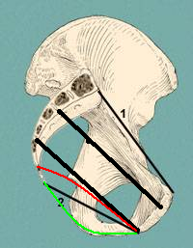
Inlet/superior strait
Cavity – most roomy place
Plane of greatest pelvic dimension
Mid pelvis
Mid pelvic plane
obstetric out let
Plane of least pelvic dimension / narrow pelvic plane
Anatomical/ bony out let

Slide 54
PELVIC AXIS
Anatomical (curve of carus) .
Anatomically pelvic axis is uniformly curved fitting with concavity of sacrum & joins the axes of pelvic inlet, cavity & outlet.
Obstetrical – through this axis foetus passes through pelvis.It’s direction is straight downward & back wards up to level of ischial spines & Then directed forward.

Slide 55
Physiological enlargement of true pelvis –
Radiological evidences show an increase in width & mobility of the symphysis pubis during pregnancy which returns to normal following delivery.
Similar changes also occur in sacro iliac jts. There is increase of the Antero posterior diameter of the inlet during labour by the rotatory movement of the sacro iliac jts. In dorsal lithotomic position, the Antero post d of the outlet may be increased to 1.5 – 2 cm.
coccyx is pushed back while the head descends down to the perineum.

Slide 56
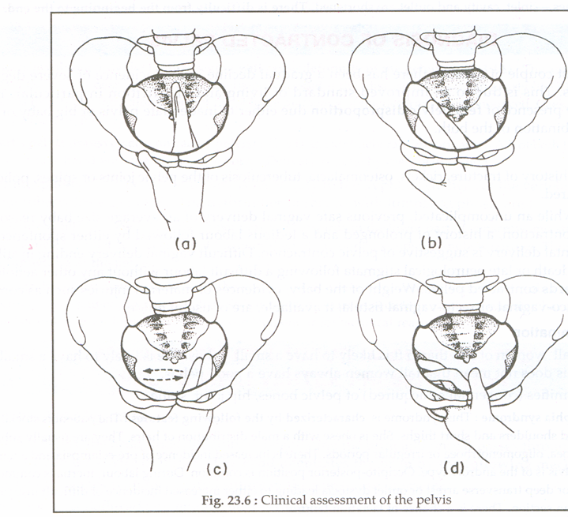

Slide 57


Slide 59
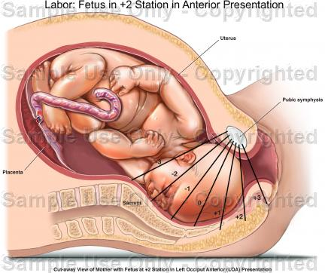
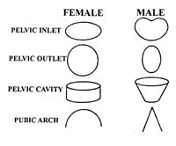

Slide 60
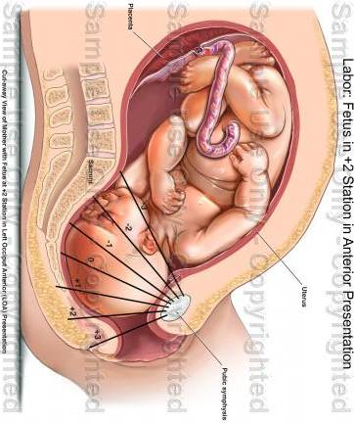
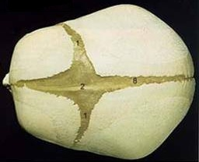

Slide 61
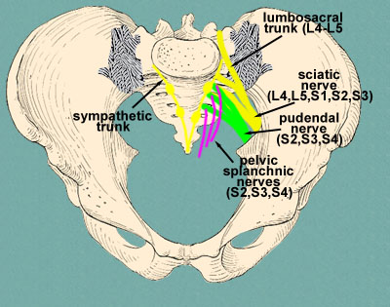

Slide 62
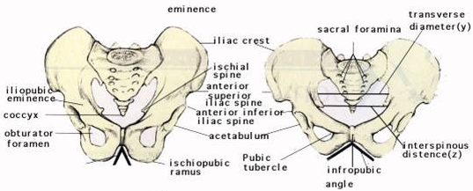

Slide 63
